Slide 1
Summary
PRAGMA Steering Committee Meeting
17 October 2006
PRAGMA 11 Workshops

Slide 2

Congratulations
Thai National Grid Center

Slide 3


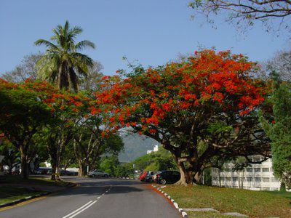

PRAGMA 15
Penang Malaysia
  Host Universiti Sains Malaysia
  Fall 2008

Slide 4
REMINDER
PRAGMA 12 in Thailand
  20 – 22 March (reception 20 March), 2007
  Geo Workshop 18 – 20 March (reception 18)

Slide 5
Steering Committee Composition
Maintain and increase success
Balance of
  Geographic distribution
  Institution distribution
Strategic Direction
Engage new talent

Slide 6
Philosophy
All members will have a two year term, which is renewable, with option of rotating off.
Institutions that host a PRAGMA workshop will be invited to join the Steering Committee for a two year period, before, during and after meeting.
Homework – by next meeting have specific language for discussion and acceptance in Operating Principles and Procedures

Slide 7
Other Items
PRAGMA Brochure: Annual Report
  Will make minor modifications and finalize
  Will have a new design for 2007 by March Meeting
SC’06
  Will look for ways to share TDW
  Will have a program that list PRAGMA demos
  Will have joint presentation on Wednesday 15 November 2006 at the NCHC booth
  Will have joint dinner on Wednesday

Slide 8
Two last topics
High Performance Distributed Computing
  An opportunity to interact with a new community
PRAGMA Institute
  Initial reaction on building capacity – uniquely PRAGMA

Slide 9
For the Next Meeting
Role of Industry in PRAGMA
With growth of PRAGMA how to make hosting of meetings more manageable

